Slide 1
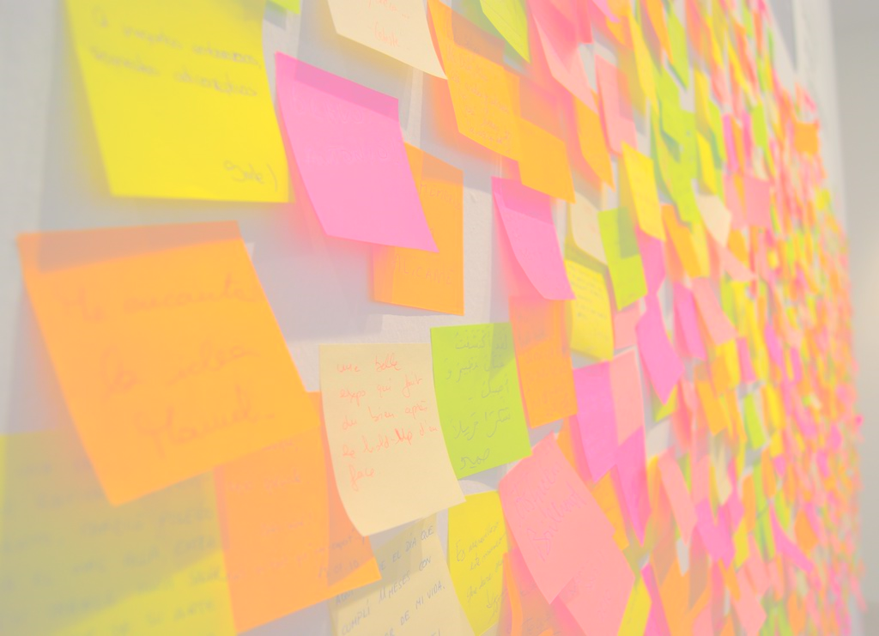
ES 1O1
A practical Introduction

Slide 2
ES: the origin
Defined by FowLer in 2005
“The fundamental idea of Event Sourcing is that of ensuring every change to the state of an application is captured in an event object, and that these event objects are themselves stored in the sequence they were applied for the same lifetime as the application state itself.”

Slide 3
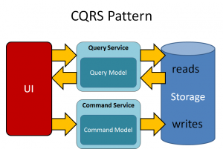
10k ft view
A service to handle customer requests
A WRITE-side data store
A bus to notify the changes
A read-side data store
Handlers to write the read side
Presentation services
Shared services

Slide 4
T01: Aggregate root
A DDD aggregate is a cluster of domain objects that can be treated as a single unit.
The aggregate root will expose methods and produces events
Contains everything needed for semantic validation
Is implemented through a list of events
Does not expose any property
Contains all the business logic

Slide 5
T02: command handler
Handle the commands send via a bus and executes the corresponding aggregate root methods
Does the syntactic validation
The commands are the imperative requests to the aggregate root

Slide 6
T03: Event store
In this project we extract the logic of the event store in a separate class
Needed to save all events
Can save a list of events taking care of the ordering
Can retrieve a list of events corresponding to a certain aggregate id

Slide 7
T04: “modifying aggregates”
As soon as an aggregate operation is executed, the corresponding events are saved
When we modify an aggregate the aggregate is loaded with the events in the store
Every modification requiring a state change has a suitable “apply” method
All modifications after the aggregate loading will be considered “uncommitted”

Slide 8
T05: Rehydration
As soon as an aggregate operation is executed, the corresponding events are saved
When we modify an aggregate the aggregate is loaded with the events in the store
Every modification requiring a state change has a suitable “apply” method
All modifications after the aggregate loading will be considered “uncommitted”

Slide 9

CQRS-04, the red pill
Notes:
Basic: https://docs.particular.net/tutorials/quickstart/
Sagas: https://docs.particular.net/samples/saga/simple/
Delayed delivery: https://docs.particular.net/nservicebus/messaging/delayed-delivery
Rabbit delayed messages: https://www.cloudamqp.com/docs/delayed-messages.html

Slide 10
nservicebus
Real service bus
Can send delayed messages
Can handle sagas
Automatically register the handlers
Can be configured to use several transport (e.g. RabbitMQ, SqlServer etc.)
We use the default di from .NET CORE
Registering the repositories
Configuring the NSB endpoints
Using the “dev” nsb channel
An API will be added to request commands
A BDD - SpecFlow suite is added

Slide 11

References
Eric Evans, Domain-Driven Design, Addison-Wesley, 2003
Jimmy Nilsson, Applying Domain-Driven Design and Patterns, Pearson, 2006
Vaughn Vernon, Implementing Domain Driven Design, Pearson, 2013
NServiceBus, https://particular.net/nservicebus
Martin Folwer, https://martinfowler.com/
Jimmy Bogard, https://jimmybogard.com/

Slide 12
Thank you for your time
Enrico Da Ros:
E-mail: edr@kendar.org
Linkedin: https://www.linkedin.com/in/enricodaros/
Slides and code: https://github.com/kendarorg/CQRS101

